Slide 1
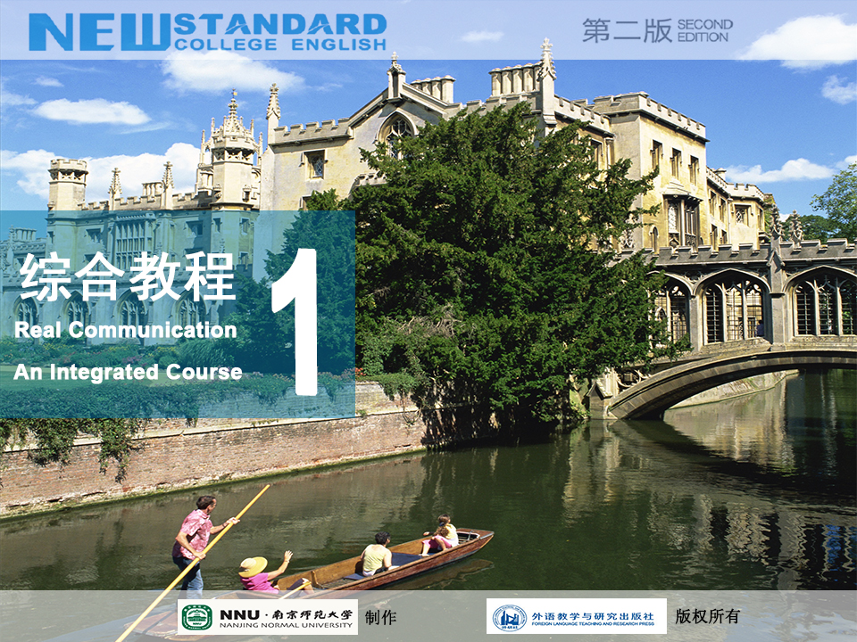

Slide 2

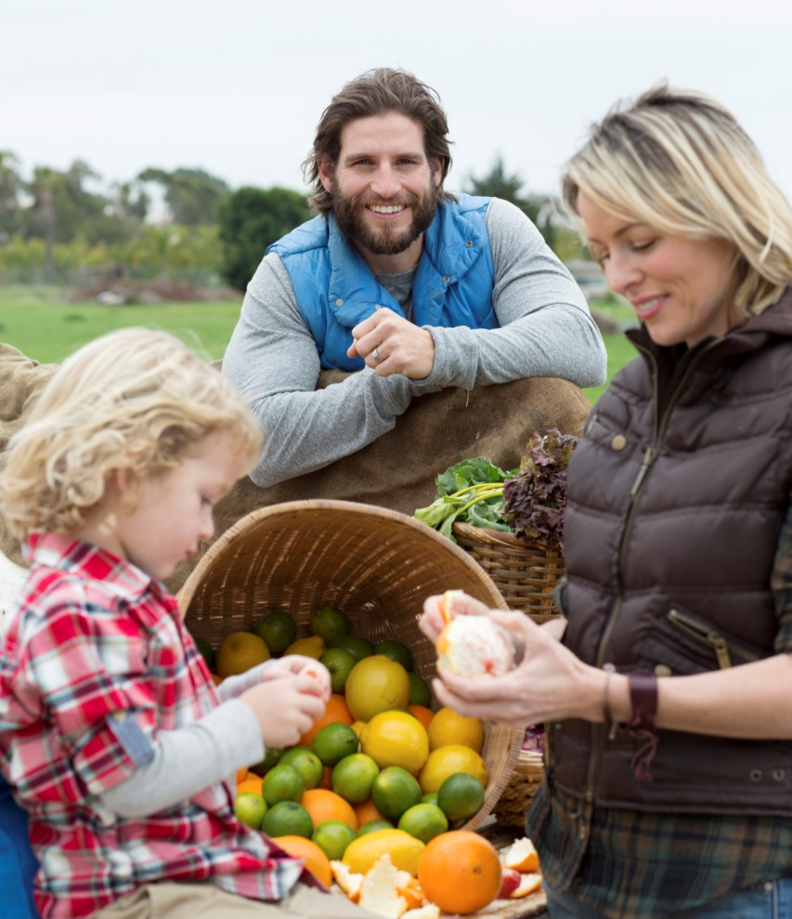






Contents
Active Reading 1

Slide 3


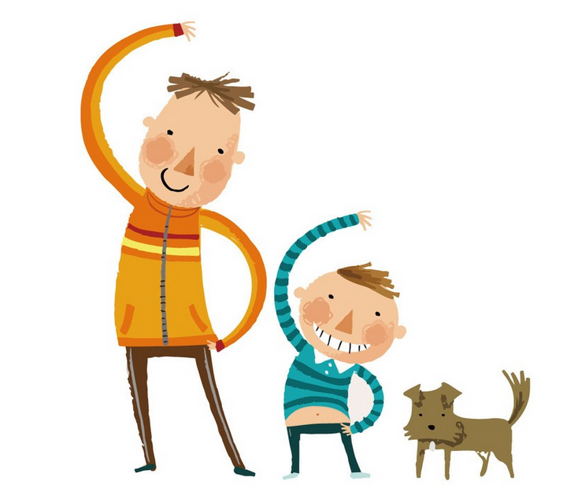
Warming Up
Listen to a POEM and fill in the missing words.
Watch a VIDEO clip and answer the questions.

Slide 4


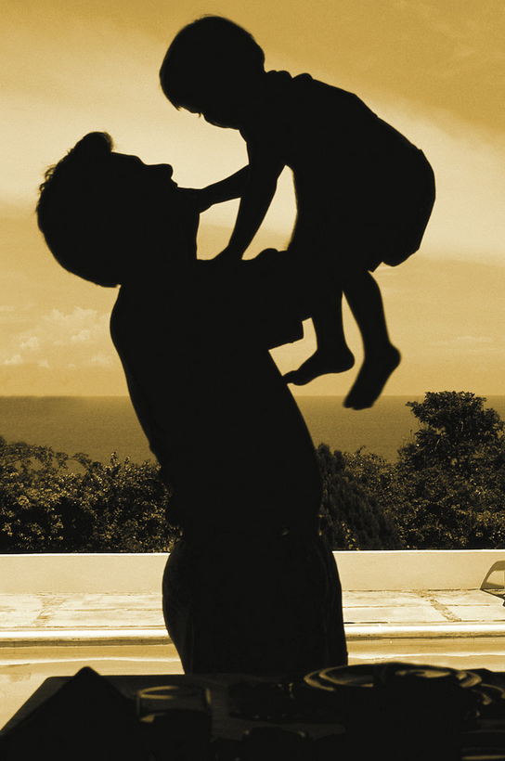

Warming Up
A Father’s Love
Fathers seldom say “I love you”
Though the feeling’s always there,
But somehow those three little words
Are the _____ ones to share.
And fathers say “I love you”
In ways that words can’t _____
With tender bedtime stories
Or a friendly game of _____!
You can see the words “I love you”
In a father’s _____ eyes.
When he runs home, all _____,
With a poorly wrapped surprise.

Slide 5
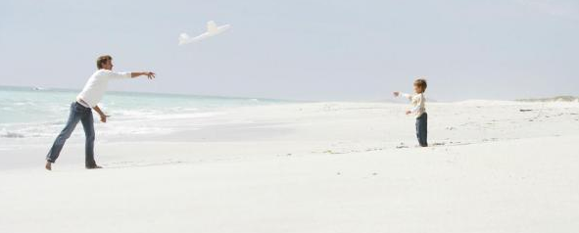
Warming Up
A father says “I love you”
With his strong _____ hands
With a smile when you’re in trouble
With the way he _____.
He says “I love you” haltingly,
With awkward _____.
It’s hard to help a four-year-old into a party dress!
He speaks his love _____
By giving all he can
To make some _____ dream come true,
Or follow through a plan.

Slide 6
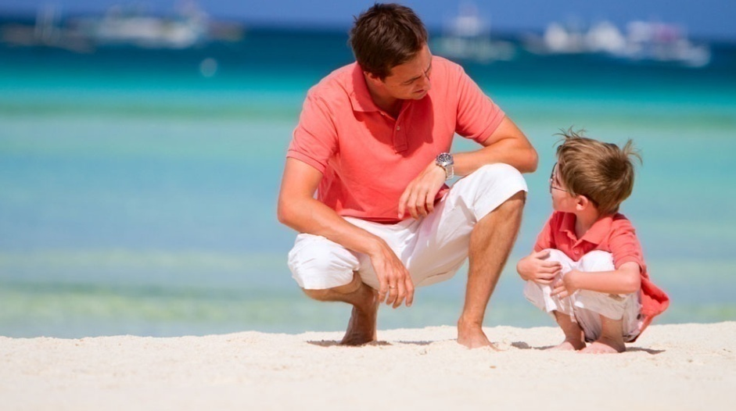

Warming Up
A father’s seldom-spoken love
Sounds clearly through the _____,
Sometimes in peals of laughter,
Sometimes through happy _____.
Perhaps they have to speak their love
In a fashion all their _____.
Because the love that fathers feel
Is too big for _____ alone!
Key

Slide 7
Warming Up
A Father’s Love
Fathers seldom say “I love you”
Though the feeling’s always there,
But somehow those three little words
Are the hardest ones to share.
And fathers say “I love you”
In ways that words can’t match
With tender bedtime stories
Or a friendly game of catch!
You can see the words “I love you”
In a father’s boyish eyes.
When he runs home, all excited,
With a poorly wrapped surprise.

Slide 8
Warming Up
A father says “I love you”
With his strong helping hands
With a smile when you’re in trouble
With the way he understands.
He says “I love you” haltingly,
With awkward tenderness.
It’s hard to help a four-year-old into a party dress!
He speaks his love unselfishly
By giving all he can
To make some secret dream come true,
Or follow through a plan.

Slide 9
Warming Up
A father’s seldom-spoken love
Sounds clearly through the years,
Sometimes in peals of laughter,
Sometimes through happy tears.
Perhaps they have to speak their love
In a fashion all their own.
Because the love that fathers feel
Is too big for words alone!

Slide 10


Warming Up
Watch a video clip and answer the following questions.
1. Who is HE in the video clip?
2. What does “Father” mean to you?

Slide 11

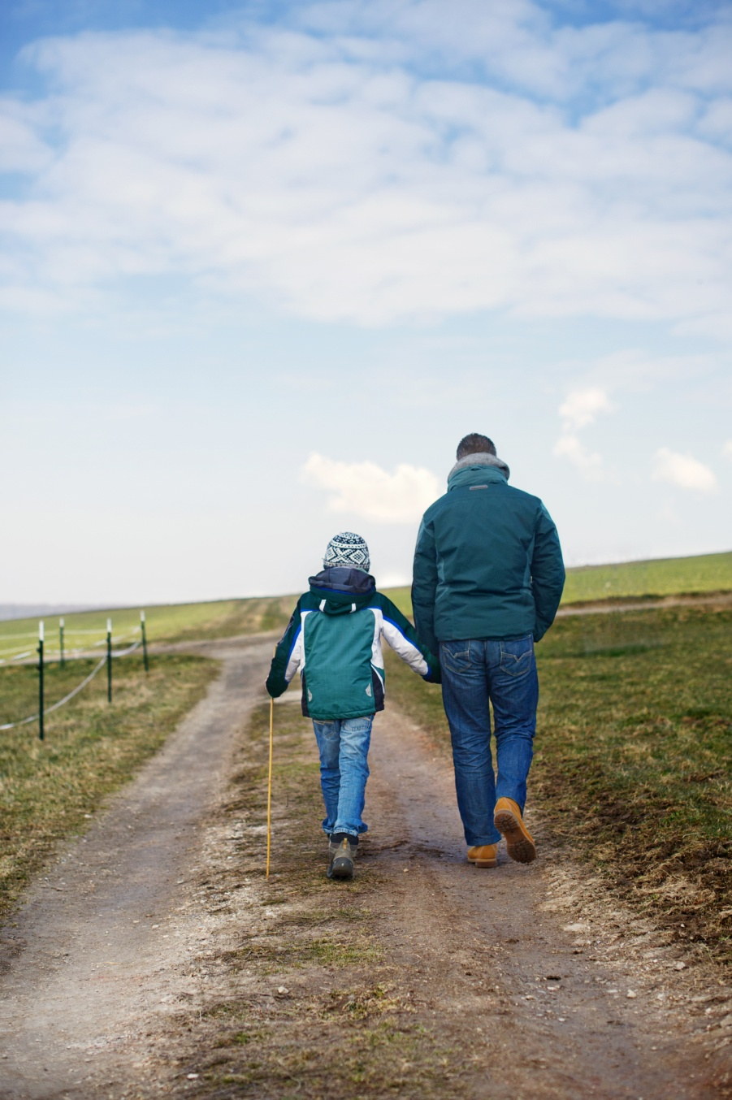
Text
The Pickle Jar

Slide 12
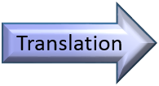
Text
The Pickle Jar
¹ As far back as I can remember, the large pickle jar sat on the floor
beside the dresser in my parents’ bedroom. When he got ready for
bed, Dad would empty his pockets and toss his coins into the jar. As
a small boy I was always fascinated at the sounds the coins made
as they were dropped into the jar. They landed with a merry jingle
when the jar was almost empty. Then the tones gradually muted
to a dull thud as the jar was filled. I used to squat on the floor in front of the jar and admire the copper and silver circles that glinted like a pirate’s treasure when the sun poured through the bedroom
window.

Slide 13
Text
2 When the jar was filled, Dad would sit at the kitchen table and
roll the coins before taking them to the bank. Taking the coins to
the bank was always a big production. Stacked neatly in a small cardboard box, the coins were placed between Dad and me on the seat of his old truck. Each and every time, as we drove to the bank,
Dad would look at me hopefully. “Those coins are going to keep you out of the textile mill, son. You’re going to do better than me. This old mill town’s not going to hold you back.” Also, each and every time, as he slid the box of rolled coins across the counter at the
bank towards the cashier, he would grin proudly. “These are for my
son’s college fund. He’ll never work at the mill all his life like me.”

Slide 14
Text
3 We would always celebrate each deposit by stopping for an ice-cream cone. I always got chocolate. Dad always got vanilla. When the clerk at the ice-cream parlor handed Dad his change, he would show me the few coins nestled in his palm. “When we get home, we’ll start filling the jar again.”
4 He always let me drop the first coins into the empty jar. As they rattled around with a brief, happy jingle, we grinned at each other. “You’ll get to college on pennies, nickels, dimes and quarters,” he said. "But you’ll get there. I’ll see to that.”

Slide 15
Text
5 The years passed, and I finished college and took a job in another
town. Once, while visiting my parents, I used the phone in their bedroom, and noticed that the pickle jar was gone. It had served its purpose and had been removed. A lump rose in my throat as I
stared at the spot beside the dresser where the jar had always stood.
My dad was a man of few words, and never lectured me on the values of determination, perseverance, and faith. The pickle jar had
taught me all these virtues far more eloquently than the most flowery of words could
have done.

Slide 16
Text
6 When I married, I told my wife Susan about the significant part the lowly pickle
jar had played in my life as a boy. In my mind, it defined, more than anything else,
how much my dad had loved me. No matter how rough things got at home, Dad
continued to doggedly drop his coins into the jar. Even the summer when Dad got
laid off from the mill, and Mama had to serve dried beans several times a week, not
a single dime was taken from the jar. To the contrary, as Dad looked across the table
at me, pouring catsup over my beans to make them more palatable, he became more
determined than ever to make a way out for me. “When you finish college, son,” he
told me, his eyes glistening, “you’ll never have to eat beans again unless you want
to.”

Slide 17
Text
7The first Christmas after our daughter Jessica was born, we spent the holiday with
my parents. After dinner, Mom and Dad sat next to each other on the sofa, taking
turns cuddling their first grandchild. Jessica began to whimper softly, and Susan took
her from Dad’s arms. “She probably needs to be changed,” she said, carrying the
baby into my parents’ bedroom to diaper her.

Slide 18
Text
8 When Susan came back into the living room, there was a strange mist in her eyes.
She handed Jessica back to Dad before taking my hand and quietly leading me into
the room. “Look,” she said softly, her eyes directing me to a spot on the floor beside
the dresser. To my amazement, there, as if it had never been removed, stood the old
pickle jar, the bottom already covered with coins.

Slide 19
Text
9 I walked over to the pickle jar, dug down into my pocket, and pulled out a fistful
of coins. With a gamut of emotions choking me, I dropped the coins into the jar. I
looked up and saw that Dad, carrying Jessica, had slipped quietly into the room. Our
eyes locked, and I knew he was feeling the same emotions I felt. Neither one of us
could speak.
■

Slide 20
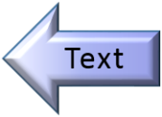
Text
爸爸的泡菜坛
1 自从我记事起，那个大大的泡菜坛就放在父母卧室的橱柜旁边的地板上。每当准备上床睡觉的时候，爸爸都会把他的衣兜倒空，将兜里的硬币投进坛子里。小时候，我对那些硬币落在坛子里发出的声响总是很着迷。当坛子几乎还是空着的时候，硬币落进去时发出的是欢快的叮当声。等到坛子快要装满的时候，叮当声便渐渐变成了沉闷的砰砰声。每当太阳透过卧室的窗户照进来的时候，坛子里圆圆的铜币和银币会像海盗的珍宝一样闪闪发光，而我便蹲在坛子前的地板上欣赏它们。

Slide 21
Text
2 坛子装满后，爸爸会坐在厨房的餐桌旁，将那些硬币用纸卷起来，然后再拿到银行去把它们存起来。把硬币存入银行可是件大事。那些硬币整整齐齐地码在一个小纸盒里，放在爸爸那辆旧卡车的车座上，在我和爸爸之间。每一次，在我们开车去银行的路上，爸爸都满怀希望地看着我，对我说：“那些硬币会让你远离纺织厂的，儿子。你会比我强。这个古老的纺织城镇是留不住你的。”每一次，当他把那盒卷好的硬币推过银行柜台交给收银员时，他都会骄傲地咧着嘴笑个不停。“这些钱是我儿子将来上大学的基金，他绝不会像我一样在纺织厂干一辈子的。”

Slide 22
Text
3 每次存完钱，我们都会买两个蛋筒冰淇淋庆贺一下。我的那一份总是巧克力味的，而爸爸的总是香草味的。当冷饮店的服务员把找回的零钱递给爸爸时，他总会把那几个硬币摊在手心里给我瞧，“回家以后，我们就又要开始往坛子里存硬币了。”
4 他总是让我把第一把硬币投进空空的坛子里。当它们发出清脆欢快的叮当声时，我们就相对咧嘴一笑。“你上大学就要靠这些1分、5分、10分和25分的硬币了，”他说，“不过，你会上大学的，我一定会让你上大学的。”

Slide 23
Text
5 许多年过去了，我完成了大学学业，在另一座城镇找到了工作。有一次，我去看望父母。我到他们的卧室打电话，注意到那个泡菜坛不见了。它已经完成了使命，被移走了。我凝视着橱柜旁那个放过泡菜坛的地方，心潮起伏，不由得一阵哽咽。爸爸是一个沉默寡言的人，从来没有对我讲过决心、毅力和信仰等的重要性。但是这个泡菜坛却教给了我这些品德，它的说服力远远胜过华丽的词藻。

Slide 24
Text
6 结婚以后，我跟妻子苏珊说起这个不起眼的泡菜坛在我的童年生活中扮演的重要角色。在我看来，它比任何一件事都更充分地体现了爸爸对我的爱。不管家里的日子多么艰难，爸爸总是坚持不懈地往那个坛子里扔硬币。甚至在爸爸被工厂解雇的那个夏天，妈妈不得不每星期做上几顿干豆子，可他们却没有从那个坛子里拿出过一分钱。相反，爸爸为我寻找出路的决心反而比任何时候都更加坚定。他看着坐在餐桌对面的我，把番茄酱倒在我的豆子上，让它们吃起来味道更好些。“大学毕业后，儿子，”他对我说，眼睛里闪着光，“你再也不必吃豆子了，除非你自己想吃。”

Slide 25
Text
7 我的女儿杰西卡出生后的第一个圣诞节，我们一家与父母一起过节。吃过晚饭后，妈妈和爸爸挨着坐在沙发上，轮流抱他们的第一个孙女。后来，杰西卡开始轻声地哭起来，苏珊便从爸爸的怀里接过她。“大概要换尿布了，”她说着，就抱着孩子到父母的卧室里去了。

Slide 26
Text
8 苏珊回到客厅后，眼睛令人奇怪地有些潮湿。她把杰西卡递给爸爸，然后拉着我的手，一言不发地将我领进卧室。“你瞧，”她轻轻地说，我顺着她的目光向橱柜旁边的地板上看去。令我感到惊讶的是，那儿放着那个旧泡菜坛，坛底已经铺满了硬币，就好像从来不曾被拿走过。

Slide 27
Text
9 我走近泡菜坛，把手伸进口袋，掏出了一把硬币。我百感交集，默默地把硬币投进坛子里。我抬起头来，看见爸爸抱着杰西卡悄悄地走进了卧室。我们四目相对，我知道他此时的心情和我完全一样。我们都激动得说不出话来。

Slide 28

Words & Phrases
pickle
glint
ice-cream cone
dresser
pirate
vanilla
toss
stack
parlor
fascinate
cardboard
nestle
jingle
textile
palm
tone
mill
rattle
mute
cashier
nickel
thud
grin
dime
squat
fund
lump
copper
cone
determination

Slide 29
Words & Phrases
perseverance
doggedly
whimper
eloquently
catsup
diaper
flowery
palatable
amazement
significant
glisten
fistful
lowly
cuddle
gamut
define
grandchild

Slide 30
Words & Phrases
each and every
play a part / role in sth.
hold sb. / sth. back
lay off
see to
to the contrary
serve its purpose
take turns
lecture sb. on / about sth.
to sb.’s amazement

Slide 31
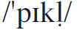
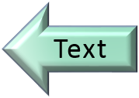
Words & Phrases
pickle n.
1. [C] (AmE) a cucumber or other vegetable preserved in vinegar or salt water 腌菜；泡菜；腌黄瓜
e.g. The dish was accompanied by a variety of pickles.
这盘菜配有什锦泡菜。
2. [U] (BrE) a thick sauce consisting of vegetables or fruit preserved in vinegar, eaten especially with cold food 腌菜酱；泡菜汁
in a sad (sorry / nice / pretty) pickle: in a difficult or unpleasant situation 处境困难或不愉快
e.g. Things are in a real pickle at the moment, I’m afraid.
My assistant’s left and I’m completely lost without him!
现在我真是处境窘迫，我的助手离开了，没有他我简直不知
道从何下手!

Slide 32
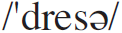
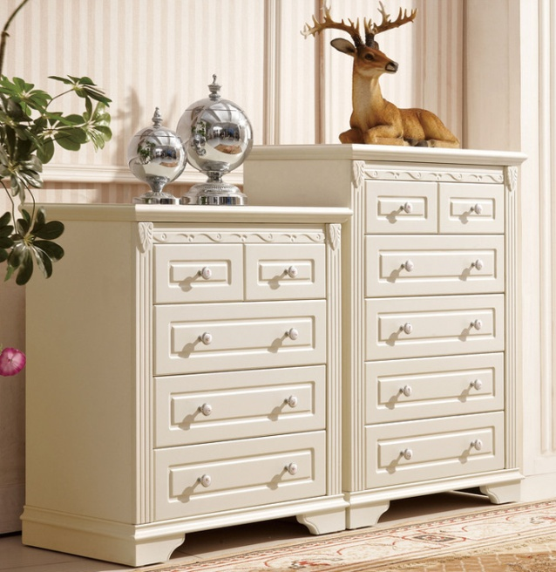
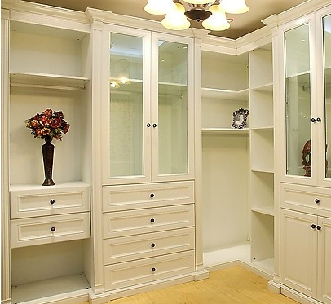
Words & Phrases
dresser n. [C]
1. (AmE) a piece of furniture used for storage, consisting of an upright frame into which drawers are fitted 五斗橱；衣柜
e.g. Mary braced herself against the
dresser and looked in the mirror.
玛丽紧贴着衣橱照镜子。
2. (BrE) a large piece of furniture with drawers and cupboards at the bottom and open shelves on top 橱柜

Slide 33
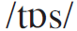
Words & Phrases
toss vt. to throw sth. somewhere gently or in a slightly careless way （轻轻地或随意地）扔，抛，掷
e.g.
1. He tossed the book down on the table.
他把书扔在桌子上。
2. They were tossing a ball about.
他们把球扔来扔去。

Slide 34
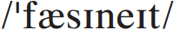
Words & Phrases
fascinate vt. to attract and interest you very strongly 强烈吸引；使着迷；使神魂颠倒
e.g.
She fascinated him, both on and off stage.
不管是台上还是台下的她，都让他着迷。
Everyone has focused on the presidential candidates, but I’m more fascinated by Michelle Obama and what she might be able to do, not just for this country, but for me as an African-American woman. (CET4-2009-12)
Word family: fascination n.
人人都关注那些总统候选人，而我却被米歇尔·奥巴马吸引，不仅期待她会为这个国家做些什么，也期待她能为我这个非裔美国女性做些什么。

Slide 35
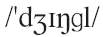
Words & Phrases
jingle
1. n. [C] the sound that small metal objects make when they hit each other 叮当声
e.g. The key fell on the ground with a jingle.
钥匙落地，发出叮当声。
2. vi. to make a sound like small metal objects hitting each other 发出叮当声
e.g. Her bracelets jingled like bells.
她的手镯叮当作响，如铃声般悦耳。

Slide 36
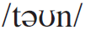
Words & Phrases
tone n. [C, U]
1. the quality of the sound made by a musical instrument, voice, or piece of electronic equipment 音质；音色
e.g. The disc has a heavy surface and the tone is faithless.
那唱片表面粗陋，音质失真。
2. the sound of sb.’s voice that shows what they are feeling 声调；腔调；语气；口气
e.g.
1. He finished off his story in an exciting tone.
他以激动的语调结束了他的故事。
2. His tone conveyed his real feelings more truly than his words.
他的语调比他的言词更真实地表达了他的实际情感。

Slide 37
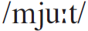
Words & Phrases
mute
1. vt. to make a sound less loud 减弱（声音）
e.g.
The strings are muted throughout the closing bars of the symphony.
该交响曲结束部分各节中的弦乐全为弱化音。
Her footsteps were muted by the thick carpet.
厚厚的地毯减轻了她的脚步声。
2. a. not speaking, or not willing to speak 缄默的；无声的；不愿说话的
e.g. He stared at me in mute astonishment.
他惊讶得目瞪口呆地盯着我看。

Slide 38

Words & Phrases
thud
1. n. [C] a low sound made by sth. heavy falling or hitting sth. （重物坠落或撞击时发出的）砰的一声，重击声
e.g. Water bounces against a stone, creating a nice thud.
水滴落到石头，发出悦耳的刷刷声。
2. vi. to make a thud when falling or hitting sth. 砰然作响；发出重击声
e.g. I could hear him thudding about upstairs in his heavy
boots.
我听见他穿着重重的靴子在楼上嗒嗒地走来走去。

Slide 39
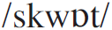
Words & Phrases
squat vi. to bend your knees and lower yourself towards the ground so that you balance on your feet 蹲
e.g.
The little boy squatted (down), staring at something far away.
小孩蹲在那儿，注视着远处。
He squatted, grunting at the pain in his knees.
他蹲在那儿，双膝痛得他直哼哼。

Slide 40
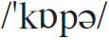
Words & Phrases
copper n. [U] a chemical element that is a red-brown metal. Its symbol is Cu and it is used especially for making wire or pipes. 铜；紫铜；红铜
e.g.
1. Is the pipe copper or lead?
这管子是铜的呢还是铅的？
2. Chile is the world’s largest producer of copper.
智利是世界上最大的产铜国。

Slide 41
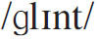
Words & Phrases
glint vi.
1. to shine with quick flashes of light 闪烁；闪光
e.g.
2. if sb.’s eyes glint, they show a strong emotion such as anger（强烈的情感在眼神中）流露
e.g. I noted his eyes glint with interest.
我注意到他的眼睛闪烁着兴趣的光芒。
She thought the diamond was lost until she saw something glinting on the carpet.
她以为那颗钻石已丢失, 后来看见地毯上有东西闪闪发光遂失而复得。

Slide 42
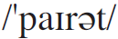

Words & Phrases
pirate n. [C] sb. who attacks ships while they are sailing in order to steal things from them 海盗；海上劫掠者
e.g.
1. In the nineteenth century, pirates roamed the seas.
19世纪时海盗猖獗。
2. Last time, they met some pirates on the high seas.
上次，他们在公海遇到了海盗。

Slide 43
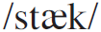
Words & Phrases
stack
1. vt. stack or stack up to arrange things so that they stand one on top of another 堆放
e.g.
1. Jack stacked the ice-cream cones together, one on top of
another.
杰克把冰激凌球摞在一起，一个一个摞上去。
2. The whole garden was stacked with bricks.
整个园子都堆满了砖。
2. n. [C] (~ of) a pile of things placed one on top of another 一叠；一摞
e.g. I saw a stack of unopened mail on his desk.
我看到他桌子上有一叠未打开的信件。

Slide 44
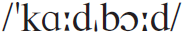
Words & Phrases
cardboard
1. a. made of cardboard 硬纸板做的
e.g. She brought the shopping home in a cardboard box.
她将买的东西放在纸箱里带回家。
2. n. [U] very stiff thick paper, used especially for making boxes（尤指用于做纸箱的）硬纸板
e.g. One day, I noticed the sole was almost off one of his
shoes and he was putting cardboard in its place.
有一天，我注意到爸爸有一只鞋子的底和面几乎完全脱离了，
他在脱开的地方塞进去一块硬纸板。

Slide 45
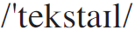
Words & Phrases
textile n. [C] woven or knitted cloth 纺织品；织物
e.g.
The treated fiber is a new type of textile material.
加工过的纤维是一种新型的纺织材料。
Exhibitions include sculpture, wood carving, painting, photography, wearable art, textile art, mixed media and ceramics.
展品包括雕塑，木刻，画作，摄影，穿戴品，纺织品，混合
媒介和陶艺。

Slide 46
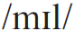
Words & Phrases
mill n. [C]
1. a factory where a product such as cotton, wool, or steel is made 制造厂；工厂
e.g. Paper is made in a paper mill.
纸是在造纸厂生产的。
2. a building where grain is made into flour 磨粉厂；磨坊
e.g. This old mill has been grinding away for over 50 years.
50多年来，这间老磨坊一直在磨粮食。

Slide 47
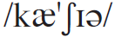
Words & Phrases
cashier n. [C] sb. whose job is to receive or give money in shop, bank etc. 出纳员； 收银员
e.g.
The cashier smiles across that bar code reader and asks, “Paper or plastic?”
收银员隔着那台条码扫描仪，微笑着问我，“用纸袋还是塑
料袋？”
My mother is a cashier at a fast-food restaurant.
我母亲是一家快餐店的收银员。

Slide 48
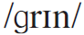
Words & Phrases
grin
1. vi. to smile showing your teeth 露齿而笑；咧嘴笑
e.g.
1. He grinned at me, as if sharing a secret joke.
他朝我龇牙一笑, 好像彼此会心领略一个笑话。
2. He grins, delighted at the memory.
想到往事，他开心地咧嘴笑了起来。
2. n. [C] a big smile that shows your teeth 露齿笑；咧嘴笑
e.g. I know she is joking because she has a big grin on her
face.
我知道她是在开玩笑，因为她脸上笑容灿烂。

Slide 49
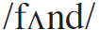
Words & Phrases
fund
1. n. [C] an amount of money that you collect, save, or invest 资金；基金； 专款
e.g.
1. The concert will raise funds for research into Aids.
这场音乐会将为艾滋病研究筹款。
2. We made a contribution to the famine relief fund.
我们给饥荒赈济基金捐了款。
2. vt. to provide the money for sth. that costs a lot 为…提供资金；资助
e.g. The airport is being privately funded by a construction
group.
该机场是由一个建筑集团私人出资兴建的。

Slide 50
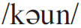
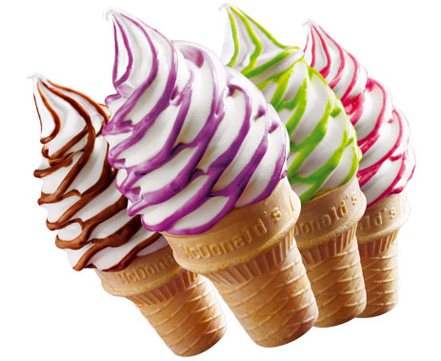
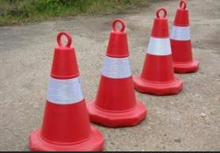
Words & Phrases
cone n. [C]
1. a cone shape that you put ice-cream in and eat 圆筒（冰淇淋）
e.g. She stopped by the ice-cream shop
and had a chocolate cone.
她路过一家冰激凌店，买了一个巧克力
蛋筒冰激凌。
2. an object with a circular base that rises to a point 圆锥；锥
e.g. The police have sectioned off part
of the road with traffic cone.
警察用锥形路标把部分路面分隔开来。
See also: ice-cream cone

Slide 51
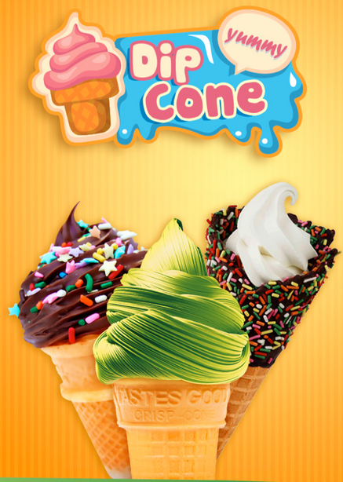
Words & Phrases
ice-cream cone n. [C] a hard thin biscuit shaped like a cone, that you can put ice-cream in, or one of these with ice-cream in it 圆筒冰淇淋
e.g. The boy gobbled up an ice-
cream cone.
那个男孩大口大口地吃完了一个
圆筒冰淇淋。

Slide 52
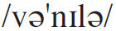
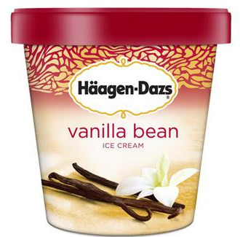
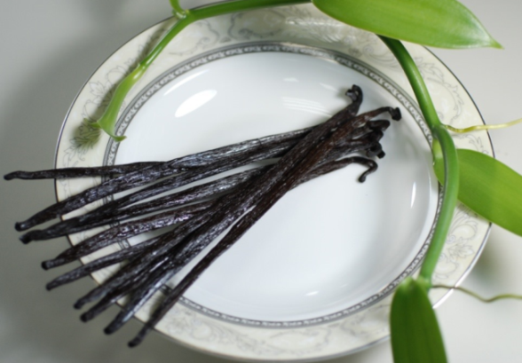
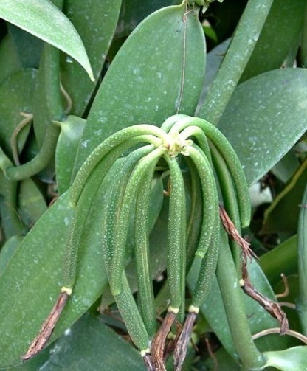
Words & Phrases
vanilla a. made from vanilla, or with vanilla added for flavour 香草制的；香草味的
e.g.
1. Add a teaspoon of vanilla extract to the juice.
在果汁中加一茶匙香草香精。
2. Add a few drops of vanilla essence.
加入几滴香草精油。

Slide 53
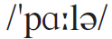
Words & Phrases
parlor n. [C]
1. a name used by some businesses for the shop or room （某些商店的）店堂，馆
e.g.
1. They scouted around for a beauty parlor.
他们四处寻找美容院。
2. He ran an ice-cream parlor.
他经营一家冰淇淋店。
2. a room in a house, used for entertaining guests 客厅；起居室
e.g. The parlors of the hotels were well furnished.
旅馆的客厅都布置得很好。

Slide 54
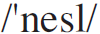
Words & Phrases
nestle v. to find a comfortable and safe position to be in, or to put sb. or sth. in such a position （使）安顿下来；舒适地躺下
e.g.
1. He nestled (down) among the cushions.
他在一堆垫子里舒服地躺着。
2. John took one child into the crook of each arm and let
them nestle against him.
约翰一只臂弯搂着一个孩子，让他们舒服地靠着他。
Word family: nest n.

Slide 55
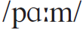
Words & Phrases
palm n. [C] the inside part of your hand, between your fingers and your wrist 手掌；手心
e.g.
1. He cupped her chin in the palm of his hand.
他用手心托着她的下巴。
2. Don slapped the table with the palm of his hand.
唐用手掌拍着桌子。
3. She placed her hands palm uppermost in her lap.
她把手心向上放在大腿上。

Slide 56
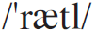
Words & Phrases
rattle vi.
1. if sth. rattles, it makes short sharp knocking sounds as it moves or shakes 发出短促尖厉的敲击声；发出嘎嘎声
e.g.
1. The old bus rattled along the stony road.
那辆旧公共汽车哐啷哐啷地沿碎石路行驶。
2. A cart full of milk-bottles rattled past.
一辆载满牛奶瓶的车子嘎嘎作响地驶过。
2. to talk idly and at length; to chatter 神聊；喋喋不休
e.g. He rattled on about his job, not noticing how bored she
was.
他喋喋不休地说工作上的事，没注意到她有多么腻烦。

Slide 57
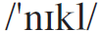
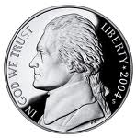
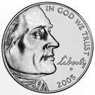
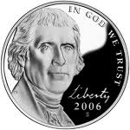
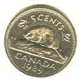
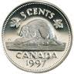
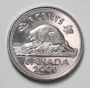
Words & Phrases
nickel n. [C] a coin in the US and Canada worth five cents （ 美国和加拿大的）五分镍币
e.g.
1. May I have a nickel?
能给我五分钱吗?
2. Don’t take any wooden nickels.
[美俚]（临别用语)再见，多加小心，别再上当。
US nickels
Canadian nickels

Slide 58
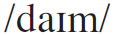




Words & Phrases
dime n. [C] a coin worth ten cents in the US and Canada （美国和加拿大的）十分硬币
a dime a dozen: (infml) nearly worthless or very common 几乎一文不值的； 极便宜的； 很普通的
e.g. Novels like this one are a dime a dozen!
这样的小说多如牛毛!
five-and-dime: (also dime store) a shop / store that sells a range of cheap goods 廉价店
US dimes
Canadian dimes

Slide 59

Words & Phrases
lump n. [C]
1. a solid piece of sth. that does not have a regular shape （ 不定形的）块
e.g.
The potter shaped and squeezed the lump of clay into a graceful shape.
制陶工人把黏土块捏塑成优美的形状。
He is breaking a piece of coal into small lumps outside.
他正在外面把一块煤砸成小块。
2. a small hard part on or under your skin that is caused by illness or injury 肿块
e.g. She has a terrible lump on her neck.
她颈上有个可怕的大肿块。

Slide 60

Words & Phrases
determination n. [U] the refusal to let anything prevent you from doing what you have decided to do 坚定；决心
e.g.
He is not a leader with courage and determination.
他不是一个果敢的领导者。
We are all moved by her dogged determination to learn English.
我们全都被她学英语的那种坚定不移的决心所感动。
Word family: determine v. determined a.

Slide 61

Words & Phrases
perseverance n. [U] a determined attitude that makes you continue trying to achieve sth. difficult 毅力；锲而不舍
e.g.
They showed great perseverance in the face of difficulty.
他们面对困难表现出了非凡的毅力。
There is a saying that “nothing is impossible”. To make the impossible possible, we must exercise our perseverance and strong willpower. (CET4-2011-06)
有种说法叫“一切皆有可能”。为了把不可能的事变成可能，
我们必须发挥我们的坚韧毅力和坚强意志。
Synonym: persistence

Slide 62

Words & Phrases
eloquently ad. expressing what you mean using clear and effective language 雄辩地；口才流利地
e.g.
1. She spoke eloquently on the subject for about an hour.
他就此主题生动地讲演了一个小时。
2. She spoke eloquently about the need for action.
她雄辩地阐述了采取行动的必要性。
Word family: eloquent a. eloquence n.
e.g. Wealth of words is not eloquence.
宏辞非雄辩。

Slide 63

Words & Phrases
flowery a.
1. flowery language or writing uses many complicated words that are intended to make it more attractive 词藻华丽的
e.g.
1. Her letter was full of flowery language.
她的信里全是花言巧语。
2. A straightforward talk is better than a flowery speech.
巧言不如直说。
2. decorated with a pattern of flowers 饰有花卉图案的；印花的
e.g. The girl was wearing a flowery dress.
那姑娘身穿一条花裙子。

Slide 64

Words & Phrases
significant a.
1. very important 重要的；意义重大的
e.g.
Time would appear to be the significant factor in this whole drama.
时间似乎是整部剧中一个举足轻重的因素。
This is one of the most significant studies of the subject.
这是对该学科最重要的研究之一。
2. very large or noticeable 相当数量的；显著的
e.g. A significant number of teenagers here are illiterate.
这里有相当一部分少年是文盲。
Word family: significance n.

Slide 65

Words & Phrases
lowly a. with a low status or position 地位低的；级别低的
e.g.
1. Her husband is a lowly government clerk.
他丈夫是政府部门的一个小职员。
2. He was not ashamed of his lowly origins.
他并没有为自己卑微的出身而感到羞耻。

Slide 66

Words & Phrases
define vt.
1. to be a feature or quality that shows exactly what sb. or sth. is 是…的特征；为…的特色
e.g.
1. It is his work that really defines him.
正是他的工作使得他与众不同。
2. Reason defines human beings.
理性是人类的特征。
2. to describe clearly and exactly what sth. is 使明确；规定；说明
e.g. The powers of a judge are defined by law.
法官的权力是由法律规定的。
Word family: definition n.

Slide 67

Words & Phrases
doggedly ad. in a way that sb. is determined to achieve sth. and continuing to try despite difficulties 坚持不懈地；顽强地
e.g.
The young man was spending his hotel evenings doggedly reading Hegel, usually falling asleep in an hour or so over the open book.
这个年轻人每天晚上都在旅馆里勤奋攻读黑格尔的著作，常
常不合书本，睡上一两个小时。
They fought doggedly but fell short on flexible tactic.
他们打得很顽强，但灵活性较差。

Slide 68


Words & Phrases
catsup n. [U] (AmE) a thick red sauce made from tomatoes （调味）番茄酱
e.g.
I use a special dressing and homemade catsup.
我用了特别的佐料和自制蕃茄酱。
And a hamburger with all the works – mustard, catsup, pickle, lettuce and onion.
另外还要一个汉堡，全部作料都要，芥末，番茄酱，泡菜，
生菜和洋葱。

Slide 69

Words & Phrases
palatable a.
1. tasting good enough to eat or drink 好吃的；可口的
e.g. Let’s drink a very palatable local red wine.
让我们喝一种口味很好的本地葡萄酒。
2. acceptable 合意的；可接受的
e.g.
1. The truth is not always very palatable.
事实真相并非总能尽如人意。
2. Some of the dialogue has been changed to make it more palatable to an American audience.
有些对白有所修改以适应美国观众的口味。

Slide 70


Words & Phrases
glisten vi. if sth. glistens, it shines because it is wet or covered with oil （潮湿或油亮的表面）闪亮
e.g.
1. The lake glistens in the moonlight.
湖水在月光下闪烁。
2. His cheeks glistened with tears.
他的脸颊因流泪而闪闪发亮。

Slide 71

Words & Phrases
cuddle v. if you cuddle sb., you put your arms round them and hold them close to show that you like or love them 搂抱；拥抱
e.g.
1. The lovers kissed and cuddled on the sofa.
那对恋人在沙发上又亲又抱。
2. The child cuddled her doll (to her chest).
那孩子（怀里）抱着玩具娃娃。
cuddle up (to / against sb. / sth.); cuddle up (together): to lie close and comfortably; to nestle 挨在一起舒适地躺着；依偎
e.g. She cuddled up to her mother.
她偎依着她母亲。

Slide 72


Words & Phrases
grandchild n. [C] the son or daughter of one of your children （外）孙女；（外）孙子
e.g. He loves his grandchild very much.
他非常喜欢他的孙子。

Slide 73

Words & Phrases
whimper
1. vi. to make small sounds of pain, fear, or sadness （因疼痛、害怕或悲伤而）抽泣， 呜咽
e.g.
1. The child was lost and began to whimper.
那孩子迷了路，开始抽泣。
2. She lay at the bottom of the stairs, whimpering in pain.
她躺在楼梯底部，痛得呜咽着。
2. vt. to say sth. in a voice that expresses pain, fear, or sadness 呜咽或啜泣着说（某事）
e.g. “Please don’t leave me alone,” she whimpered.
“请不要丢下我不管，”她抽抽搭搭地说。

Slide 74

Words & Phrases
diaper
1. vt. to put a nappy on a baby 给婴儿换尿布
e.g. The father never diapered the baby, never bathed it.
那个父亲从不给婴儿换尿布，也不给它洗澡。
2. n. [C] (AmE) a baby’s nappy; piece of toweling cloth or similar soft padding folded round a baby’s bottom and between its legs to absorb or hold its urine and excreta 婴儿尿布
e.g. I just nursed him and changed his diaper, and he’s
crying again.
我刚给他喂完奶，换了尿布， 他却又哭了。

Slide 75

Words & Phrases
amazement n. [U] a feeling of being very surprised 惊奇；惊诧
e.g.
She looked at him in amazement.
她惊诧地看着他。
Imagine my amazement when a 70-year-old man beat me at tennis.
在网球赛中，我竟被一位70岁的老人击败，请想像一下我当
时的惊愕状态。
Word family: amaze v.
e.g. He amazed everyone by passing his driving test.
他驾驶考试合格真让大家感到惊奇。
See also: to sb.’s amazement

Slide 76


Words & Phrases
fistful n. [C] (~ of) the amount of sth. you can hold in your fist 一把
e.g. Jack handed me a fistful of coins.
杰克递给我一把硬币。
Similar word formation:
mouthful 一口；满口
handful 一（小）把

Slide 77

Words & Phrases
gamut n. [sing] the complete range of things of a particular type （某一类东西的）全部，整个范围
e.g.
1. The network will provide the gamut of computer services.
这个网络将提供全方位的计算机服务。
2. It does not cover the whole gamut of Scottish poetry.
它并未涵盖所有苏格兰诗歌。
run the gamut (of sth.): to experience or to perform the complete range of sth. 全过程
e.g. In his short life, he had run the entire gamut of crime,
from petty theft to murder.
他在短短的一生中，从小偷小摸到杀人，什么罪都犯过。

Slide 78
Words & Phrases
each and every: used to emphasize that you are talking about every person or thing in a group 每一个，无例外（用于加强语气）
e.g.
The teacher must know the name of each and every pupil.
教师必须知道每个学生的名字。
This method attends to each and every aspect of the matter.
这是个面面俱到的办法。

Slide 79
Words & Phrases
hold sb. / sth. back: to stop sb. or sth. from succeeding as they should 阻碍…的成功（或发展）
e.g.
Such despicable behaviour, can not hold back the friendship of the Chinese and British People.
这些卑鄙的伎俩阻挡不了中英两国人民的友谊。
Long-term water shortages can hold economic development back.
长期的缺水会阻碍经济的发展。

Slide 80
Words & Phrases
see to: to deal with or take charge of sb. or sth. 办理；照料
e.g.
This machine isn’t working; get a mechanic to see to it.
这台机器坏了，找技工来修理一下吧。
Will you see to the arrangements for the next committee meeting?
你来处理下次委员会会议安排，好吗?
see to it that ... 一定注意到…；务必…
e.g. See to it that you’re ready on time!
到时候你千万要准备好!

Slide 81
Words & Phrases
serve its purpose: if sth. has served its purpose, it has done what you needed it to do 起到应有的作用
e.g.
The legislation on state secrets needs to be overhauled because it fails to serve its purpose.
有关国家机密的立法亟待改革，因为这些法律未能发挥应有
的作用。
Design doesn’t serve its purpose without people to use it.
如果没有人使用，设计根本无法发挥作用。

Slide 82
Words & Phrases
serve a / sb.’s purpose; answer a / sb.’s purpose: to help achieve sth. 管用；合用
e.g.
Here take my rug. It will serve the purpose of keeping you warm later.
给，带上我的毛毯，一会儿冷了可以保暖。
This room will answer the purpose until we find something better.
在我们找到更好的住处之前，这房间会管用的。

Slide 83
Words & Phrases
lecture sb. on / about sth.: to talk to sb. seriously in order to criticize them or warn them about sth., especially when this is annoying 教训；告诫；训斥
e.g.
1. He lectured the child on the importance of punctuality.
他教训那个孩子守时的重要性。
2. The teacher is always lecturing me on being late.
那老师总是训斥我迟到。
lecture (on sth.): to give a lecture or series of lectures 作演讲；讲课
e.g. He lectured on modern drama.
他讲授当代戏剧。

Slide 84
Words & Phrases
play a part / role in sth.: to be involved in sth., especially in a way that is important 在某物中起（尤指重要）作用
e.g.
It is ingenuous to suppose that money did not play a part in his decision.
如果你以为他的决定没有金钱的因素，那就太天真了。
Financial markets naturally play a part in shaping monetary policy.
金融市场理所当然在形成货币政策中发挥了重要作用。
Only when we realize the key role creativity plays can we become better selves in the foreseeable future. (CET4-2012-06)
只有当我们意识到了创造力的重要性，我们才能在不久的未来
变成更好的自己。

Slide 85
Words & Phrases
lay off: to end sb.’s employment, especially temporarily, because there is not enough work for them （尤指临时性 地）解聘（雇员）
e.g.
A hundred thousand federal workers will be laid off to reduce the deficit.
为了减少赤字，将要裁员十万联邦人员。
They did not sell a single car for a month and had to lay off workers.
他们一个月来一辆车也没有卖掉，因此不得不裁员。

Slide 86
Words & Phrases
to the contrary: making you think that the opposite may be true 相反的； 相反地
e.g.
I will come on Monday unless you write to the contrary, i.e. telling me not to come.
我将于星期一前来，除非你写信叫我别来。
I will continue to believe it until I get proof to the contrary, i.e. that it is not true.
我仍然相信这一点，除非有证据证明它与此相反。

Slide 87
Words & Phrases
on the contrary：the opposite is true 与此相反；正相反
e.g.
It doesn’t seem ugly to me; on the contrary, I think it’s rather beautiful.
我觉得它并不丑，恰恰相反，我觉得它挺美的。
You think you are clever; on the contrary, I assure that you are very foolish.
你自以为很聪明，相反地，我确信你很傻。

Slide 88
Words & Phrases
take turns: if people take turns or take it in turns to do sth., each of them does their share of it, one after the other 轮流；依次
e.g.
1. You can’t both use the bike at once you’ll have to take turns.
你们不能两人同时用这辆自行车，得轮流使用。
2. The students took turns to clean up their classroom.
学生们轮流打扫教室。
3. Susan and her brother take turns (at) doing the dishes.
苏珊和她的兄弟轮流洗盘子。

Slide 89
Words & Phrases
to sb.’s amazement: against or beyond one’s expectation 令…惊讶的是
e.g.
To my amazement, he was able to recite the whole poem from memory.
令我吃惊的是他能把整首诗背出来。
To her amazement she got the job.
令她诧异的是她得到了这份工作。
See also: amazement

Slide 90


Language Points
I used to squat on the floor in front of the jar and admire the copper and silver circles …
copper and silver circles: This refers to the small coins in the jar, which are made of copper or silver.
翻译：
我（那时）便蹲在坛子前的地板上欣赏圆圆的铜币和银币……

Slide 91
Language Points
Each and every time, as we drove to the bank …
each and every time: Here (and in another sentence in the same paragraph) the writer uses each and every time for emphasis.
翻译：
每一次，在我们开车去银行的路上……

Slide 92
Language Points
Those coins are going to keep you out of the textile mill, son.
From this and the coming sentences in the paragraph we can see that the writer’s father has been working at a textile mill. What the father means is that with the deposits, his son would have a fund to go to college and get a better-paid job instead of working in a textile mill like him. He hopes his son will prosper.
翻译：
那些硬币会让你远离纺织厂的，儿子。

Slide 93
Language Points
You’ll get to college on pennies, nickels, dimes and quarters …
The penny, nickel, dime and quarter are units of money in the US or Canada, all of which are in coin form. What the father means here is that with the coins in the jar, they will accumulate enough money to finance his son’s college education.
翻译：
你上大学就要靠这些1分、5分、10分和25分的硬币了……

Slide 94
Language Points
I’ll see to that.
I will deal with it and make sure you can go to college.
翻译：
我一定会（让你上大学）的。

Slide 95
Language Points
A lump rose in my throat as I stared at the spot beside the dresser where the jar had always stood.
When the writer saw the place where the jar had been placed, a strong emotion arose in him which almost made him cry.
a lump in your throat: a feeling that you want to cry 某人喉咙哽住；某人哽咽欲泣
e.g. It’s the kind of film that can put a lump in your throat.
这部电影让人哽咽。
翻译：
我凝视着橱柜旁那个放过泡菜坛的地方，心潮起伏，不由得一阵哽咽。

Slide 96
Language Points
My dad was a man of few words, and never lectured me on the values of determination, perseverance, and faith.
a man of few words: a man who doesn’t speak much
翻译：
爸爸是一个沉默寡言的人，从来没有对我讲过决心、毅力和信仰等的重要性。

Slide 97
Language Points
The pickle jar had taught me all these virtues far more eloquently than the most flowery of words could have done.
The pickle jar had become an emblem which represented the values of determination, perseverance and faith. It conveyed these values more effectively than the most beautiful words would have done.
翻译：
但是这个泡菜坛却教给了我这些品德，它的说服力远远胜过华丽的词藻。

Slide 98
Language Points
… he became more determined than ever to make a way out for me.
His unemployment made the father more determined to find a way for his son to escape such a hard life. In this context, the father hoped that his son would be able to go to college, which would change his life.
翻译：
……爸爸为我寻找出路的决心反而比任何时候都更加坚定。

Slide 99
Language Points
She probably needs to be changed …
Here it means that they probably need to change the baby’s diaper.
翻译：
她大概要换尿布了……

Slide 100
Language Points
With a gamut of emotions choking me …
A huge range of emotions were choking the writer so that he couldn’t speak.
翻译：
我百感交集……

Slide 101
Language Points
Our eyes locked …
lock: (literary) if two people’s eyes lock, they look directly into each other’s eyes 对视
e.g. Their eyes locked together for an instant.
他们四目相交，对视了片刻。
翻译：
我们四目相对……

Slide 102

Exercises
Reading and understanding
Dealing with unfamiliar words
Reading and interpreting
Developing critical thinking

Slide 103
Exercises
Reading and understanding
2 Answer the questions.
1 Why was the writer fascinated by the pickle jar?
2 What did the writer’s father do with the money when the jar was full?
3 What was the money for?
4 Where was the pickle jar when the writer visited his parents after leaving college?
5 How did the writer feel?
6 What had the pickle jar taught the writer?
7 Where was the pickle jar when the writer returned with his family?
8 What kind of relationship did the writer have with his father?

Slide 104
Exercises
1 Why was the writer fascinated by the pickle jar?
He was fascinated at the sounds the coins made as they were dropped into the pickle jar.
2 What did the writer’s father do with the money when the jar was full?
He took it to the bank.
3 What was the money for?
The money was to pay for his son to go to college.
4 Where was the pickle jar when the writer visited his parents after leaving college?
It was gone — he did not know where it was.

Slide 105
Exercises
5 How did the writer feel?
He felt sad.
6 What had the pickle jar taught the writer?
7 Where was the pickle jar when the writer returned with his family?
The pickle jar was on the floor beside the dresser.
It had taught him the values of determination, perseverance and faith.

Slide 106
Exercises
8 What kind of relationship did the writer have with his father?
They seemed to have a close relationship although the writer did not say this directly. The father cared for his son and his education. They both shared some deep feelings which they could not put into words.

Slide 107
Exercises
Dealing with unfamiliar words
3 Match the words for sounds with their definitions.
4 Replace the underlined words with the correct form of the words below. You may need to make other changes.
5 Answer the questions about the words and expressions.

Slide 108
Exercises
3 Match the words for sounds with their definitions.
jingle mute rattle thud whimper
1 to make small sounds of pain, fear or sadness
2 to make short sharp knocking sounds as something moves or shakes
3 the sound that small metal objects make when they hit each other
4 to make a sound less loud
5 a low sound made by something heavy falling or hitting something
whimper
rattle
jingle
mute
thud

Slide 109
Exercises
jingle mute rattle thud whimper
Now decide what word you can use to describe the sound of:
(a) a small, frightened animal
e.g. The whimpering dog was trying to escape to the corner
of the room.
(b) someone covering someone else’s mouth to stop them shouting
e.g. The enemy were coming nearer and nearer, so he
muted his friend’s shout; they must not be heard.
whimper
mute

Slide 110
Exercises
jingle mute rattle thud whimper
(c) a heavy branch falling from a tree to the ground
e.g. There was a dull thud as the box hit the floor.
(d) an old bicycle on a bad road
e.g. The old taxi rattled down the street.
(e) coins in your pocket
e.g. Just then there was the jingle of keys outside the door.
thud
rattle
jingle

Slide 111
Exercises
4 Replace the underlined words with the correct form of the words below. You may need to make other changes.
cashier define determination fascinate
fund significant stack tone toss
1 She threw the beans into a pan of boiling water.
tossed
2 I could hear the cheerful sounds of church bells through the window.
tones
3 I’ve always found her books extremely interesting.
fascinating

Slide 112
Exercises
cashier define determination fascinate
fund significant stack tone toss
4 He piled up the glinting silver coins so the bank clerk could count them.
stacked; cashier
5 My grandfather gave an important sum of money to my college savings.
significant; fund
My grandfather gave a significant sum of money to my
college fund.
6 My dad’s hard work and motivation and love described our relationship.
determination; defined

Slide 113
Exercises
5 Answer the questions about the words and expressions.
1 If something holds someone back, is it likely to (a) stop them from doing something, or (b) help them to do something?
2 If someone sees to something, do they (a) take responsibility, or (b) refuse to take responsibility for it?
3 If someone lectures you on something, do they (a) talk to you seriously to criticize you, or (b) give you a talk about a serious subject?
4 If you do something with perseverance, do you (a) keep trying with determination, or (b) do it because you’ve been told to?
5 Answer the questions about the words and expressions.
1 If something holds someone back, is it likely to (a) stop them from doing something, or (b) help them to do something?
2 If someone sees to something, do they (a) take responsibility, or (b) refuse to take responsibility for it?
3 If someone lectures you on something, do they (a) talk to you seriously to criticize you, or (b) give you a talk about a serious subject?
4 If you do something with perseverance, do you (a) keep trying with determination, or (b) do it because you’ve been told to?

Slide 114
Exercises
5 If someone speaks eloquently, do they (a) use only a few words, or (b) say something in a clear and effective way?
6 If you do something doggedly, do you do it (a) even if it’s difficult, or (b) only when it’s easy?
7 If you get laid off from your job, does it mean (a) you get a better job, or (b) you lose your job?
8 If you want to make a salad palatable, do you want to make it (a) more quickly, or (b) taste better?
9 Is a gamut of emotions likely to be (a) a single emotion, or (b) a series of emotions?
5 If someone speaks eloquently, do they (a) use only a few words, or (b) say something in a clear and effective way?
6 If you do something doggedly, do you do it (a) even if it’s difficult, or (b) only when it’s easy?
7 If you get laid off from your job, does it mean (a) you get a better job, or (b) you lose your job?
8 If you want to make a salad palatable, do you want to make it (a) more quickly, or (b) taste better?
9 Is a gamut of emotions likely to be (a) a single emotion, or (b) a series of emotions?

Slide 115
Exercises
Reading and interpreting
6 Work in pairs. Decide what the metaphors mean.
1 Taking the coins to the bank was always a big production.
Going to the bank with the savings was a big drama or celebration. In the bank the father was proud to show the cashier how he was saving for his son; going to the ice-cream parlour afterwards was also a special occasion, including getting some change to start saving again.
2 “You’ll get to college on pennies, nickels, dimes and quarters,” ...
“You’ll get to college by saving small coins, if we save enough of them over a period of time.”

Slide 116
Exercises
3 A lump rose in my throat ...
I felt sudden sadness because I remembered how Dad supported my education through years of saving.
4 ... there was a strange mist in her eyes.
She felt strong emotions because she knew what the pickle jar had meant for her husband and she knew it was now a jar for their daughter.

Slide 117
Exercises
Developing critical thinking
7 Work in pairs and discuss the questions.
1 Is it always important for a child to “do better” than their parents?
2 During the rough times, would it have been better to spend the money on food instead of saving for a college education?
3 Do you think the core values of the writer’s family would be different if college education were free?

Slide 118
Exercises
1 Is it always important for a child to “do better” than their parents?
No, I don’t think it is. This attitude puts too much pressure on a child and diminishes the importance of happiness.
If children have the opportunity to do better than their parents, they should take it. It shows respect for sacrifices the parents have made.

Slide 119
Exercises
2 During the rough times, would it have been better to spend the money on food instead of saving for a college education?
The sensible idea in this situation is to prioritize spending, so the family should have bought food and waited until better times before saving for college. Besides, the child could always get a job to pay their fees while studying.
The important point is that the parents are happy to sacrifice their comfort for their child’s future. For example, the writer’s parents didn’t mind eating beans to give him the best chance in life. This shows their determination.

Slide 120
Exercises
3 Do you think the core values of the writer’s family would be different if college education were free?
Some of the values would be similar, but the value of saving might be different because savings for college fees would not be needed if college education were free.

Slide 121


Extension Activities
1. Group Discussion
2. Additional Readings

Slide 122

Extension Activities
Group Discussion
1. Discuss with your partner on what YOU have done to strengthen the relationship between YOU and your Father / Mother.
2. When YOU become a Father / Mother, what will you do to build a good relationship between YOU and your Son / Daughter?

Slide 123
Extension Activities
Additional Readings
Tips for improving parent-child relationship :
Our parents need our understanding
Five ways for mothers to connect with sons
Task:
Give personal comments on the points made in the readings.

Slide 124
Extension Activities
Our parents need our understanding
People all go through the childhood trauma of not understanding why your parents are being so mean to you. You tell them that they’re ruining your life and that you hate them, and that you will never forgive them for what they’re doing to you. You write in your journals how horrible they are to you and that you will never be mean like them when you become a parent, but how much do you know about their side of the story? The chances are that you probably don’t understand what they might be going through. But, are you willing to listen? Are you seriously paying attention to how much they love you? If you’re not, then here is a cheat sheet to get it through your head:

Slide 125
Extension Activities
It’s harder than it looks:
When I was a little girl, I used to go on a lot of mall trips with my mother and my siblings. We’d shop, eat food court food and shop some more, and it all seemed effortless. What I didn’t know until later is that my mother was going through some of the roughest things of her life during those times. I won’t say what it was, but it was pretty rough and she took us shopping to keep the three of us distracted. So, if your mother decides to take you somewhere just for the hell of it, take her aside once you’re back home and everything’s settled down. Take her aside and ask her if she’s okay and if she needs anything at all or if she just needs to talk. If you do that, you’re just beginning to see how it is to be your mother. She’ll probably say that she doesn’t need anything and that she’s fine, but she will appreciate that you took the time out to ask.

Slide 126
Extension Activities
They have to say no sometimes:
Seriously, parents can’t say yes all of the time because you’ll end up spoiled rotten. My mother was watching Wife Swap the other day and there was a teenage girl, who said that she would ask her parents for something and they would say no, but all she had to do was wait a few minutes and they would come back and say yes. What kind of parents are those? If I had a quarter for each time my parents said yes, I’d be a millionaire. However, they did tell me no just as much, so I’d be a millionaire either way. If your parents tell you that you can’t drive the car or spend the night at your friend’s house or go to a party, don’t let it impact your entire life. This is just one “no” in the millions of times that you’ll hear “yes”.

Slide 127
Extension Activities
They scream because they love:
If your parents scream at you, take it all in stride and they’ll forgive you. Don’t take advantage of this, though, because the day that they stop screaming will be the day that you should fear. Why do I say that? I say this because when they scream at you, it means that they still care. When they stop screaming and basically tell you that they don’t care if you lay down on railroad tracks, they mean it. So, let them scream. They’ll eventually get it out of their system. However, if they’re being verbally abusive, that’s an entirely different story and you need to speak to someone about that.

Slide 128
Extension Activities
Listen to their advice, you may need it someday:
If you’re a girl and your mother tells you to tuck in your bra strap or your thong, listen to her. Not only is this a fashion faux pas but you will get laughed at, because people (especially kids) are cruel. On the more serious note, when your parents give you any type of advice, try to remember it. Sure, you may roll your eyes and think that it’s old people’s logic, but that advice will help you later. If you have to, write the advice down in your diary or journal later instead of writing down what latest complaints you have against your parents. See, your parents won’t be around forever, so you won’t be able to come back to them 10 or 20 years down the line and get the advice to give to your own children.

Slide 129
Extension Activities
So, understanding your parents is the best thing that you could ever do, so read this and maybe you can give this to your children one day.
What will you do if you have your own child (children) in the future?

Slide 130
Extension Activities
Five ways for mothers to connect with sons
It isn’t always easy to connect with our sons. It seems to me that possessing the ‘Y’ chromosome automatically enrolls you into a male club, of which mothers are not a part. My husband and son share a lot of hobbies and interests. They ride dirt bikes and I don’t have one. They like to watch football, which I hate. Then there is the ball throwing and kicking that I am horribly inept at. But this doesn’t mean that I can’t find my own ways to connect with my son and so can you. Read on for five ways that you can connect with your son and build a strong mother son relationship.

Slide 131
Extension Activities
1. Find a common interest
At first finding a common interest may seem like a daunting task. After all you were never a boy. Start by thinking about the things that your son likes to do. Maybe you both like to ride bicycles or run. Try taking a self-defense class together.

Slide 132
Extension Activities
2. Read
Reading to your son is a great way to connect with him. When he’s young, pull him onto your lap and read picture books. During grade school try reading novels. I read every night to my son. Kids can usually understand and enjoy a book two-grade levels above what they can read themselves. As your son grows, try reading the same book and then discussing it over ice-cream of course.

Slide 133
Extension Activities
3. Play together
My son likes to play his Playstation. So I purposely bought a game that two players could play. Then we play together. We like to jump on the trampoline together. Besides being great exercise for me it’s a wonderful time to connect with my son. We also like to play board games together. Our favourites are Sorry and Monopoly Junior. Younger boys will enjoy playing cars with you or chasing you around the house.

Slide 134
Extension Activities
4. Be his cheerleader
I am no good at playing sports. But I am a great spectator. Whatever your son is involved in, encourage him. Attend his games, concerts, or recitals. Be there and let him know that you are proud of him.

Slide 135
Extension Activities
5. Love and listen
Let your son know that you love him. Tell your son at least once a day that you love him. Give him a hug. My son can’t go to bed without a hug from his mom. Part of loving your son is taking time to listen to him. Find out how his day went. What concerns does he have? Did something great happen? Take time each day to talk and listen. Moms are much better at this than dads.

Slide 136


Thank you

